Slide 1
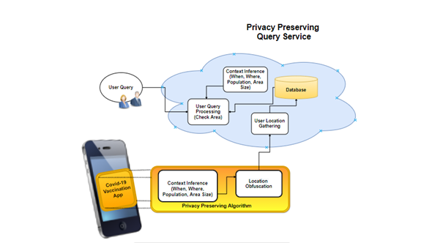
Privacy Preserving Covid-19 Vaccination Status Query for Proactive Infection Prevention
Presentation by: Adrian Golias, Csilla Turnar, Via De Catalina

Slide 2
Introduction
Present vaccination coverage in given locations
We are presuming that validated vaccination data is entered into our app
Phones send their obfuscated location and their vaccinated status hourly to the cloud
A task runs hourly to generate percentage of vaccination coverage in every location
When a user sends a query the application will return a percentage of vaccination coverage in their current location

Slide 3
Related work/literature review
Vaccination tracking systems
blockchain based (Deka et al.)
distributed ledger based (acyclic graph) (Bencic et al.)
Privacy Preserving/Differential Privacy
Covid 19 Tracing apps: ENS, TraceTogether
Laplace Mechanism
Location Tracking
Triangulation , AGPS

Slide 4
Testing
Test1
Comparison of real location data versus masked data
Test2
Quorum check with high and low density population in the area
Density check – will the system maintain consistency?
Test 3
Scalability check – can a query expand to cover wider area?

Slide 5
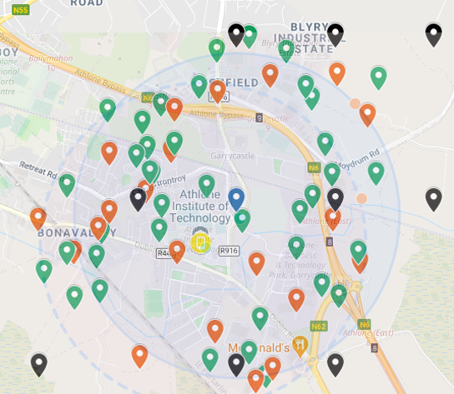

Test 1 - Results
Predefined/obfuscated Areas – Black
Query Device – Yellow
Masked Query Device – Blue
Vaccinated Devices – Green
Non-vaccinated Devices- Red
Dotted circle represents actual query area
Blue shaded circle represents obfuscated query area
Results

Slide 6
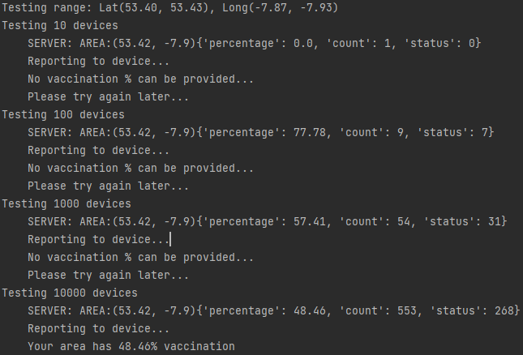
Test 2 - Results
Area density test
Results of low vs high density
Server query rejection

Slide 7
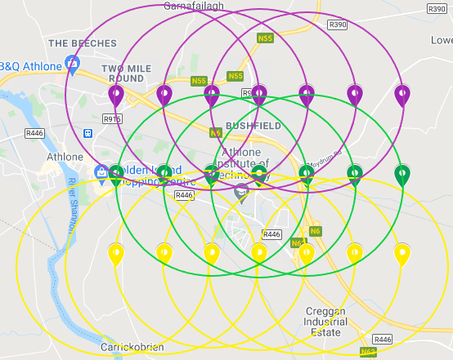
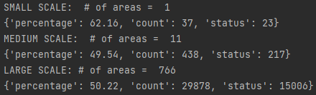
Test 3 - Results
Scalability check covering wide query area
Small scale query: 0.66 Km radius
Medium scale query: 1.34 Km radius
Large scale query: 13.4 Km radius
Results

Slide 8
Conclusion
The app gives accurate results
Privacy is preserved
Scalable

